Slide 1
Using TypeScript and Office 365 Enterprise Services in Angular Applications

Slide 2






Andrew Connell
www.AndrewConnell.com
me@AndrewConnell.com
@andrewconnell
Independent Consultant, Developer, Speaker, Instructor
Hands-On SharePoint Training Critical Path Training - www.CriticalPathTraining.com
On-Demand SharePoint Training Pluralsight – www.Pluralsight.com

Slide 3


Want to Learn More?
www.CriticalPathTraining.com
Hands-On & Virtual Training
www.Pluralsight.com
On-Demand Training
SharePoint Courses for Everyone
SharePoint 2007, 2010 & 2013
Developers, Administrators & End Users
Get Training How You Like it
Hands-On (classroom with hands-on labs)
Online (live webcast with take-away labs)
Private Classes Available for Large Groups
SharePoint Courses for Everyone
SharePoint 2007, 2010 & 2013
Developers, Administrators & End Users
Individual, Small Business & Enterprise Plans
Monthly or Annual Subscriptions
Watch Online & Offline
Subscribers Have Access to Entire Catalog
me@andrewconnell.com

Slide 4
Topics
Why & What – TypeScript
How - TypeScript
Office 365 Enterprise Services
TypeScript, Office 365 & Angular

Slide 5
Why & What - TypeScript

Slide 6
Why TypeScript?
Superset of JavaScript
Modular
Scalable Application Structure
Strong Typing
Tooling Support
EcmaScript 6 Standards

Slide 7
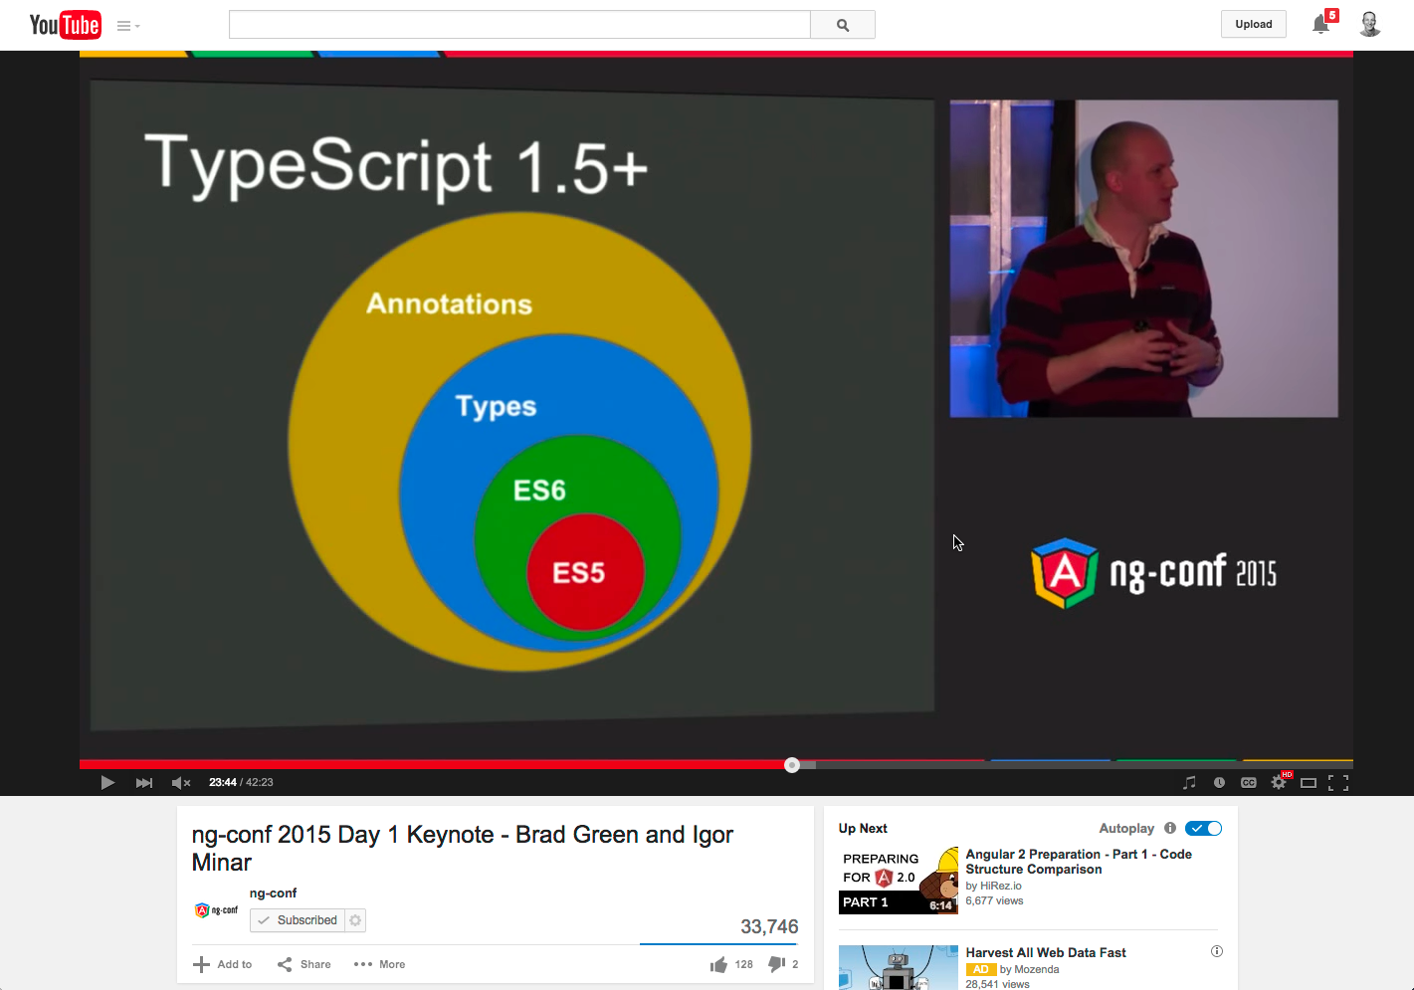
Why TypeScript with Angular?
https://youtu.be/QHulaj5ZxbI?t=20m53s

Slide 8
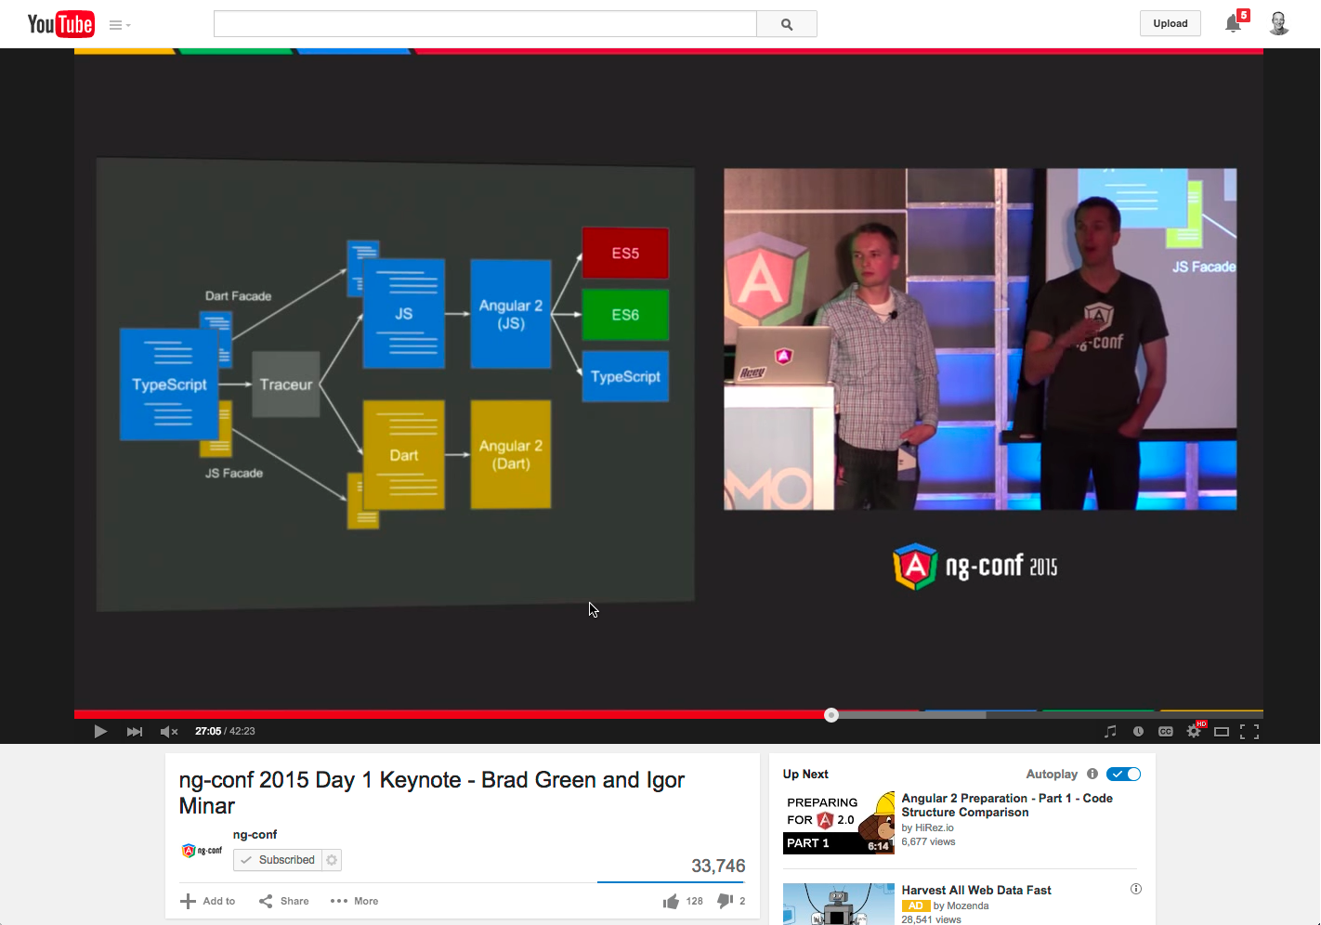
Why TypeScript with Angular?
https://youtu.be/QHulaj5ZxbI?t=27m5s

Slide 9
What is TypeScript?
Strongly Typed
Classes
Interfaces
Generics
Modules
Type Definitions
Compiles to JavaScript
EcmaScript 6 Features

Slide 10
DEMO - TypeScript Playground

Slide 11
How TypeScript

Slide 12
Wide Editor Support
Out-of-the-Box Support
Visual Studio
WebStorm
Support via add-ins
Sublime Text
Brackets
Anything… leverage
Gulp or Grunt

Slide 13
DEMO - TypeScript & Editor Support

Slide 14
Office 365 Enterprise Services

Slide 15
Office 365 as a Enterprise Service
Fastest growing Microsoft product
Contains collaborative data in SharePoint
Contains Exchange data (contacts, calendar & email)
Files (via OneDrive)
All data accessible via REST APIs
More APIs coming!

Slide 16
Custom App Challenges in O365
Cloud App Model vs. SharePoint Hosted
OAuth access tokens must be protected
Requires server-side intermediary
Client-side apps using OAuth tokens require proxy to talk to SharePoint / O365 APIs

Slide 17
Secure Client-Side Apps with ADAL JS
Azure AD now supports the OAuth implicit flow
Enables 100% client-side authentication
Apps must explicitly opt-in to this flow option
ADAL JS
Comprised in two components:
adal.js – core… not designed for direct use
adal.angular.js – Angular service

Slide 18
DEMO - Office 365 & ADAL in Angular with TypeScript

Slide 19
What Next?
Hands-on Lab
https://github.com/OfficeDev/TrainingContent/tree/master/O3657
See module O3657-2
Presentation & slides
https://github.com/andrewconnell/pres-o365-ng-typescript

Slide 20

Thanks! Questions?
github.com/andrewconnell/pres-o365-ng-typescript

